Slide 1
Module 2: Version Control With GIT

Slide 2
What to Expect?
What is Git?
GIT Lifecycle
How does Git Work?
Some Git Commands?
More Git Commands?
What Is Git?
Git is a version-control system for tracking changes in computer files and coordinating work on those files among multiple people. It is primarily used for source-code management in software development, but it can be used to keep track of changes in any set of files.

Slide 3
GIT Lifecycle.
Following are the life cycle stages of GIT:
Working Directory:
The place where your project resides in your local disk.
This project may or may not be tracked by git.
In either case, the directory is called the working directory.
The project can be tracked by git, by using the command git init.
By doing git init, it automatically creates a hidden .git folder.
Staging Area:
Once we are in the working directory, we have to specify which files are to be tracked by git.
We do not specify all files to be tracked in git, because some files could be temporary data which is being generated while execution.
To add files in the staging area, we use the command git add.

Slide 4
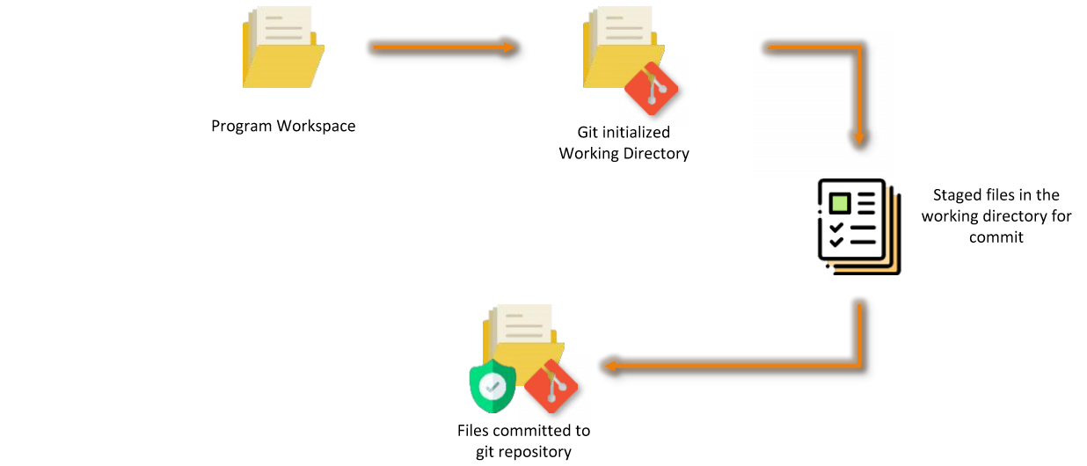
Git Life Cycle Continued…
Commit:
Once the files are selected and are ready in the staging area, they can now be saved in repository.
Saving a file in the repository of git is known as doing a commit.
When we commit a repository in git, the commit is identified by a commit id.
The command for initializing this process is git commit –m “message”.

Slide 5
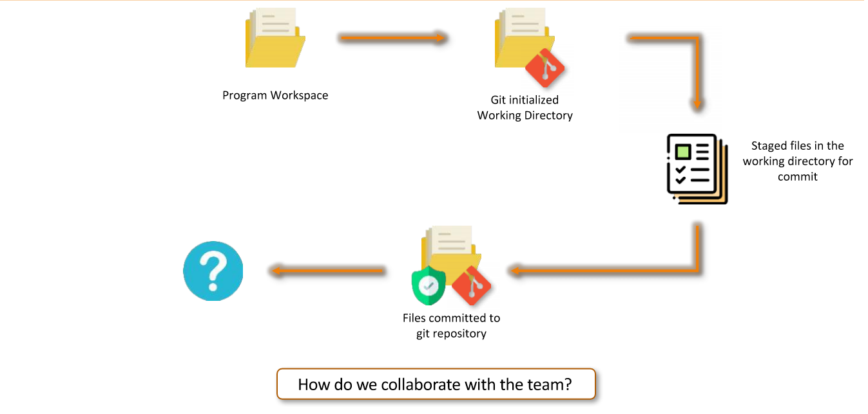
Git Life Cycle Continued…

Slide 6
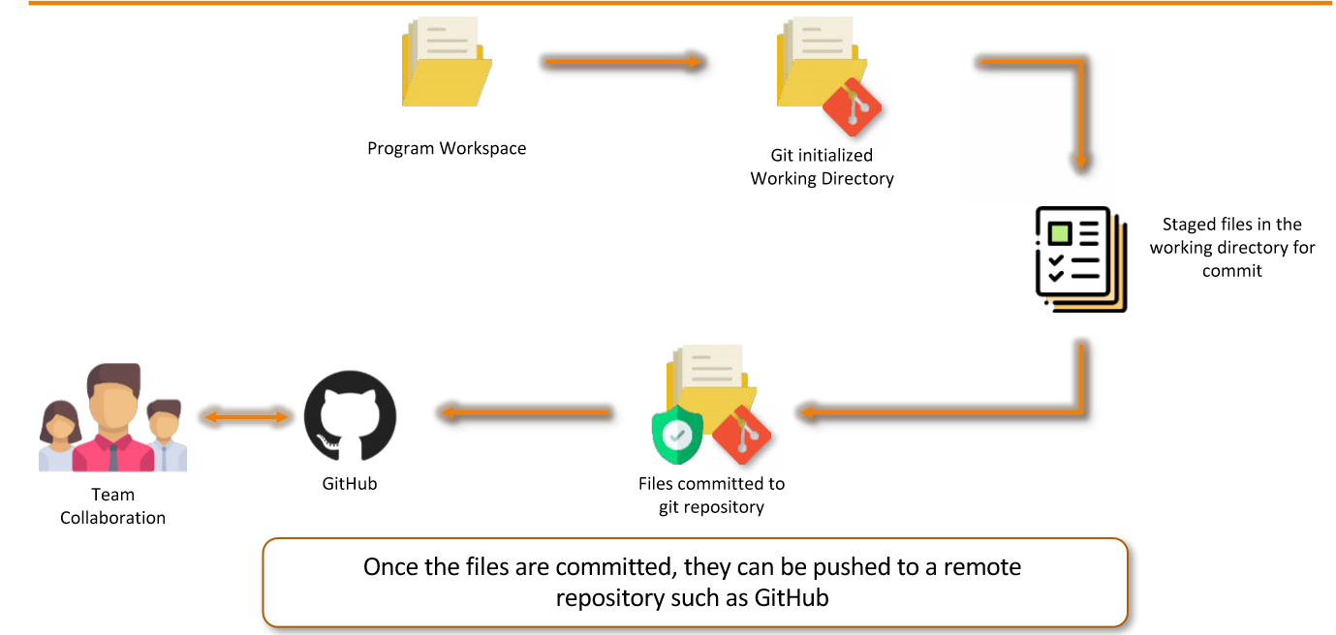

Slide 7
How Does Git Work?
When we edit the project or add any new functionality, the new code is again committed to git, a new commit ID is assigned to this modified project. The older code is store by git, and will be accessible by it’s assigned Commit ID.
All these commits are bound to a branch. Any new commits made will be added to this branch. A branch always points to the latest commit. The pointer to the latest commit is known as HEAD.
The default branch in a git repository is called the Master Branch.
But Why Master Branch?
Say , a developer has been assigned enhance this code by adding Feature A. The code is assigned to this developer in a separate branch “Feature A”. This is done, so that master contains only the code which is finished, finalized and is on production.
Therefore , no matter how many commits are made by this developer on Feature A branch, it will not affect the Master Branch.
Once the code is finished, tested and ready we can merge the Feature A branch, with the master branch and now the code is available on the production servers as well.

Slide 8
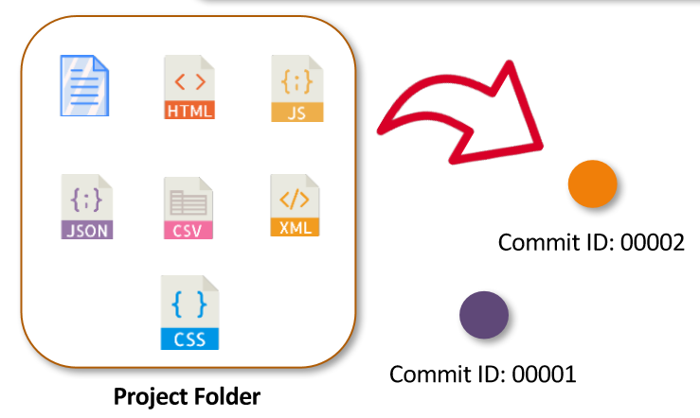
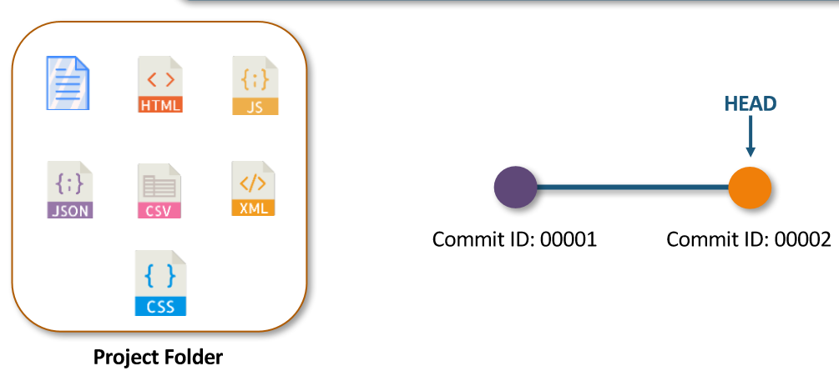
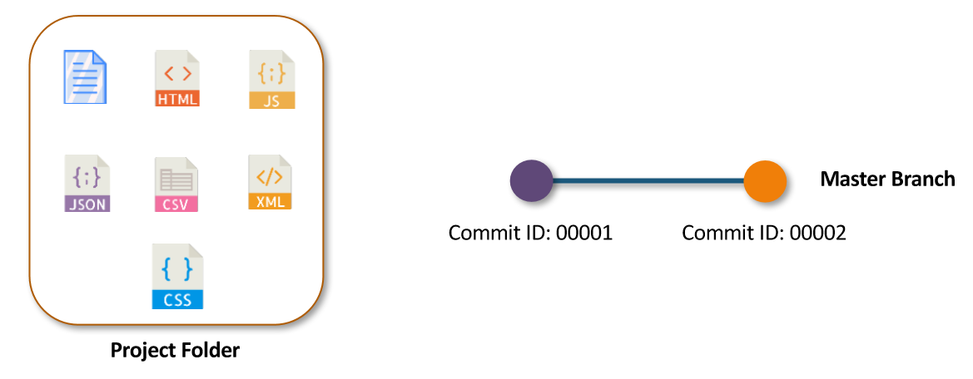
How Git Works?

Slide 9
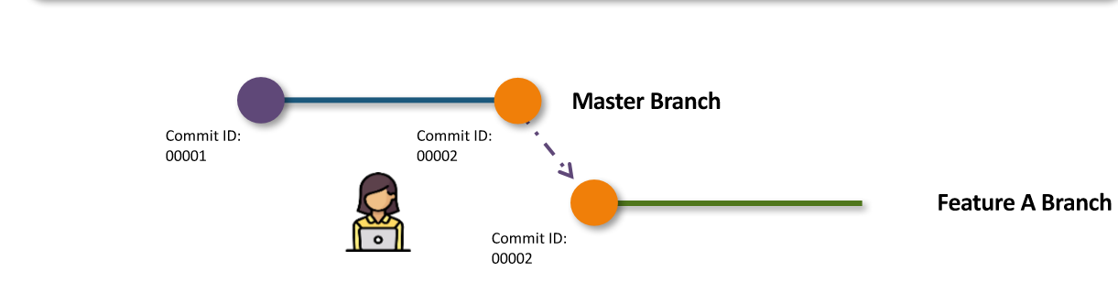
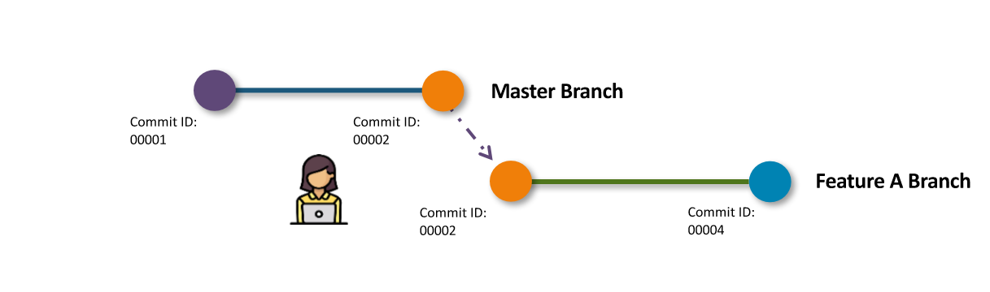
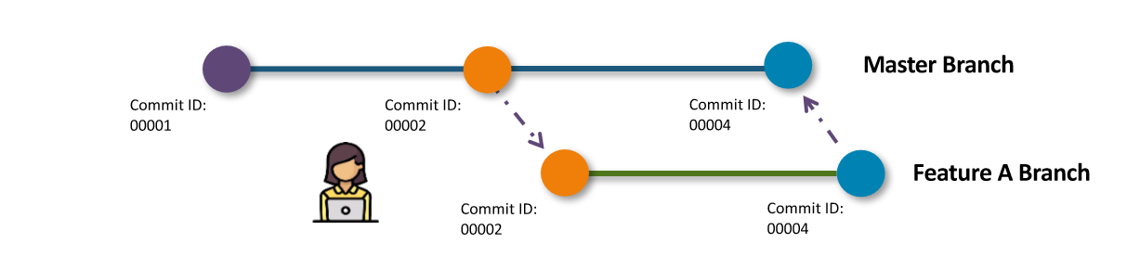
How Git Works?

